Slide 1
Understanding the
Action Potential
Will Johnson and Ni Feng

Slide 2
Learning goal
Students will understand what drives action potentials in neurons.
Before this class, students will have watched a video introducing action potentials in neurons.
Notes:
Will

Slide 3
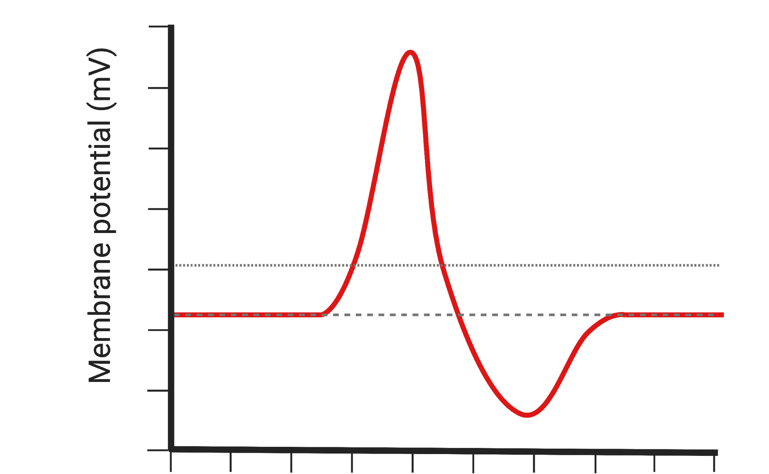
Learning objectives
Students will be able to:
Resting membrane potential
Depolarization
Repolarization
Definite equilibrium potential
Calculate equilibrium potential for an ion given its concentration in and out of the neuron
Understand ionic movements that contribute to membrane potential at each stage of the action potential
Time (ms)
Biorender.com
Notes:
Jenny

Slide 4
Electric Potential
+
-
+
-
+
Electric potential differences make charged particles move
Positive charges move toward negative potentials, and negative charges move toward positive potentials.
+
-
-
+
+
-
-
+
-
-
+
-
+
-
+
-
+
-
+
Notes:
Will

Slide 5
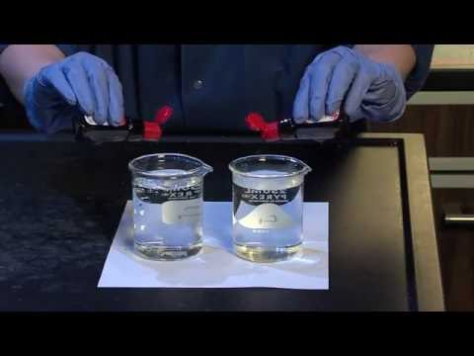
Concentration Gradient
Particles move from areas of higher concentration to areas of lower concentration
Notes:
Will

Slide 6
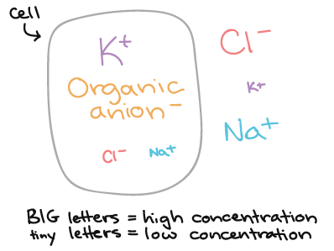
Concentration gradients of charged ions create membrane potentials
https://www.khanacademy.org
Notes:
Jenny Note that membrane has to be permeable to ions.
https://www.khanacademy.org/science/biology/human-biology/neuron-nervous-system/a/the-membrane-potential

Slide 7
The equilibrium potential is the electrical potential difference across the cell membrane that exactly balances the concentration gradient for an ion.
The equilibrium potential is calculated by the Nernst equation:
Because neurons are mainly permeable to K+ at rest, their resting membrane potentials are close to K+’s equilibrium potential, which is negative.
Concentration gradient
K+
-
-
-
+
+
+
K+
Electrical gradient
Notes:
Jenny
The equilibrium potential for an ion is calculated with the Nernst equation, which takes into account ion concentration in and out of the neuron, and assumes it’s the only permeable ion
The ion will go down its concentration gradient, pushing the membrane potential towards its equilibrium potential / happy place
At the equilibrium potential, there is zero net movement across the membrane

Slide 8
During an action potential, permeability of ions change when channels for specific ions open or close.
If an ion’s channel opens, it will move across the membrane toward its equilibrium potential, changing the neuron’s membrane potential.
Explore how ionic movements drive membrane potential change in this jamboard breakout session:
https://jamboard.google.com/d/1qOn24VMpZk5nROrIoiXy_OZARMnFrN9Oi1ZXMyqwIEk/viewer?ts=6059fd79&f=0
Notes:
Jenny

Slide 9
Jamboard activity answer:
Resting membrane potential
Depolarization
Repolarization
Na+ equilibrium potential
K+ equilibrium potential
Time (ms)
Notes:
Will

Slide 10
Optional think-pair-share question:
If the neuron is permeable to ion X but not Y at rest, then the neuron’s resting membrane potential is: A. Equal to ion X’s equilibrium potential
B. Equal to ion Y’s equilibrium potential
Notes:
Answer: A

Slide 11
Group discussions
Please get in groups of 3-4 and work through the discussion question associated with your group number. Designate one person as the note taker, another as the person to report back to the main group. [15min]
Groups representatives will take turns to describe their questions and answers, with a minute of follow up questions from the audience. [30min]
Notes:
Jenny

Slide 12
Group discussion questions
Using the same action potential diagram: calculate Cl- equilibrium potential and draw it as a line across the action potential. Next, discuss how Cl- ions will behave if Cl- channels open, and how it will impact the membrane potential.
Glial cell resting membrane potential is equal to the equilibrium potential of K+, what does this mean?
In neurons, resting membrane potential is slightly more positive than the Keq, what does that mean, how would you test your hypothesis?
What happens if K+ channels open first, then Na+ channels? Draw the resulting action potential shape.
Notes:
A slightly more complicated question for after students learn about channel inactivation: What would happen if Kv channels cannot open during the action potential? Draw the action potential shape.

Slide 13
Answers
Using the same action potential diagram: calculate Cl- equilibrium potential and draw it as a line across the action potential. Next, discuss how Cl- ions will behave if Cl- channels open, and how it will impact the membrane potential. (It will go inside the neuron because its concentration is higher outside, and it would hyperpolarize the neuron or silence/inhibit it).
Glial cell resting membrane potential is equal to the equilibrium potential of K+, what does this mean? (It means that the only conducting ion is K+ at rest; only K+ channels are open at rest)
In neurons, resting membrane potential is slightly more positive than the Keq, what does that mean, how would you test your hypothesis? (It means that in neurons, K+ is not the only conducting ion. I would test what other ions are passing through the membrane by using selective channel blockers, and see if the resting membrane potential changes.)
What happens if K+ channels open first, then Na+ channels? Draw the resulting action potential shape (It would be inverted!

Slide 14
Muddiest point
Please spend 5 min to write down the “muddiest point” from this lecture

